Slide 1
MGT 217
Class 9
10/3

Slide 2
Overview
Emotions
Stress
Work-life balance
Case Study– “Amazon” due Wed

Slide 3
Emotions in Organizational Behavior
“If your emotional abilities aren't in hand, if you don't have self-awareness, if you are not able to manage your distressing emotions, if you can't have empathy and have effective relationships, then no matter how smart you are, you are not going to get very far.”
    —Dr. Daniel Goleman, psychologist, scientist, and author
Notes:
People or events elicit a variety of feelings that cause us to respond in different ways. These feelings are called affects, a broad term covering a wide range of feelings including emotions and moods. We may react to certain situations with sadness, anger, or elation. These responses are emotions, intense feelings directed at a specific object or person. ² Emotions are numerous and intense, but they are usually also short-lived.

Slide 4
Emotions in Organizational Behavior
Emotions in Organizational Behavior
Emotion—Intensity of and generalized feelings toward a person or object.
Positive/Negative Affect
  Positive – excitement, cheerfulness, and self-assurance
  Negative – boredom, lethargy, and depression
Emotional State – Paramount when making important decisions
Notes:
What if your professor has caught you on a day when you feel like you cannot be bothered working at all? In fact, now that you think about it, you have felt a bit down for the past few days. A short deadline is the last thing you need when you are feeling this unmotivated. In this case, you are probably experiencing a negative mood, which consists of less intense and more generalized feelings not directed at a specific object or person. Moods last longer than emotions. Of course, moods can also be positive, and we often categorize ourselves and others as being in a “good mood” or a “bad mood.”
OB researchers have identified two basic types of mood dimensions: positive affect and negative affect. Positive affect includes emotions such as excitement, cheerfulness, and self-assurance, while negative affect includes emotions such as boredom, lethargy, and depression.⁴ The sources of moods and emotions are complex. Factors such as lack of sleep and exercise, the weather, and the amount of stress we are under might play a part, but there are no concrete answers to explain the underlying reasons for our feelings and moods.
Our emotional state is paramount when it comes to making important career decisions. For example, people who are in a heightened emotional state and are unhappy with their current roles sometimes jump into new positions without fully assessing the realities of what the new job has to offer. In this situation, job seekers need to think about how they would feel about taking the job now and into the future.
Most of us are prone to heightened emotional states. In your personal life, when you are feeling frustrated, angry, or disappointed, your reaction might be to shout, storm out, or curl up in a quiet place for a while. However, in the workplace, these emotional outbursts could seriously damage your professional reputation as well as your work performance. Not only does a lack of self-control over your emotions affect you, but your negative responses can also spread to others around you.

Slide 5
Emotional Contagion
Emotions in the Workplace
Emotional contagion is a phenomenon in which emotions experienced by one or more individuals in a work group spread to the others.
Notes:
We may not realize it, but our moods and emotions are contagious and have a strong influence on group behavior. Emotional contagion is a phenomenon in which emotions experienced by one or more individuals in a work group spread to the others. Researchers have found that negative emotions tend to spread more quickly than positive emotions, which can affect morale, productivity, and motivation. Positive emotional contagion creates an environment in which people work better together, experience less conflict, and experience higher levels of work performance. Managers and leaders who have a positive attitude generally have the ability to inspire their employees to work well together.

Slide 6
Emotional Regulation
Emotions in the Workplace
Emotional regulation is a set of processes through which people influence their own emotions and the ways in which they experience and express them.
Antecedent
Response-focused
Notes:
Every day we are exposed to different situations, which can trigger a range of strong emotions. In fact, one of life’s biggest challenges is keeping our emotions in check. Inappropriate or extreme responses are disruptive and will not be tolerated in a working environment. Most of us try and control our feelings through emotional regulation, a set of processes through which people influence their own emotions and the ways in which they experience and express them. The two main kinds of regulation strategies are antecedent-focused and response-focused.

Slide 7
Emotional Intelligence
Emotions in the Workplace
Emotional intelligence (EI) is the ability to understand emotions in ourselves and others in order to effectively manage our own behaviors and our interpersonal relationships.
Notes:
Imagine you are working on a complex project and one of your teammates is such having difficulty in carrying out his role that he slows down the rest of the team and jeopardizes the deadline. Do you complain to your boss that this employee is letting the team down? Or do you try and manage the situation by supporting your teammate and helping him learn the right skills? If you chose the latter option, you probably have high levels of emotional intelligence (EI), the ability to understand emotions in ourselves and others in order to effectively manage our own behaviors and our interpersonal relationships. Organizations are beginning to base hiring and promoting decisions on EI, and it is considered as important to professional success as other abilities such as technical skills.

Slide 8
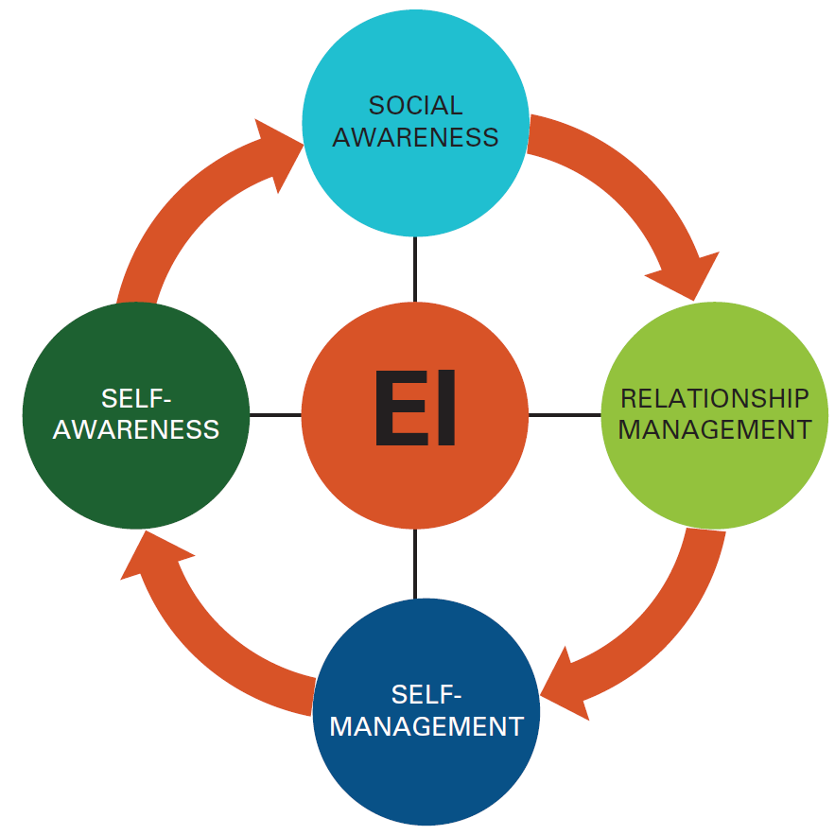
Figure 3.2 The Four Dimensions of EI
Notes:
There are four dimensions of EI:
Self-Awareness: A good understanding of your own emotions.
Self-Management: The ability to control and regulate emotions and impulses.
Social Awareness: Skills in perceiving, empathizing with, and reacting appropriately to the emotions of others.
Relationship Management: The ability to manage the emotions of others to build strong and healthy relationships with them.

Slide 9
Stress in the Workplace
Stress is a response that occurs when a person perceives a situation as threatening to his or her well-being when his or her resources have been taxed or exceeded.
Notes:
Most of us know what it feels like to be stressed. We may feel under pressure about making a deadline, taking an exam, or giving a presentation in front of a large audience. We define stress as a response that occurs when a person perceives a situation as threatening to his or her well-being when his or her resources have been taxed or exceeded. Stress in the workplace can affect the behavior of people working in an organization, leading to poor health and absenteeism. Statistics show that 60% of illnesses are caused by stress, which costs the U.S. $300 billion every year on medical bills and loss of productivity. ³

Slide 10
Jobs Rated from Least Stressful (1) to Most Stressful (250)
Adapted from Table 4-1
Least Stressful Jobs | Stress Level | Most Stressful Jobs | Stress Level
2. Florist | 18.80 | 245. Surgeon | 99.46
6. Appliance Repairer | 21.12 | 246. Taxi Driver | 100.49
8. Librarian | 21.40 | 248. Senior corporate exec | 108.62
10. File clerk | 21.71 | 249. Firefighter | 110.93
11. Piano tuner | 22.29 | 250. U.S. President | 176.55
4-10

Slide 11
Discussion Questions
Should the most stressful jobs also be paid the most? Why do you think this isn’t the case?
How does the job you currently occupy rank on the stress scale? What aspects of that job are the most stressful?
4-11

Slide 12
Stressors
Stress in the Workplace
Stressors are environmental stimuli that place demands on individuals. There are two main types:
Challenge stressors
Hindrance stressors
Notes:
Stressors are environmental stimuli that place demands on individuals. There are two main types:
Challenge stressors are associated with workload, job demands, job complexity, and deadlines and are positively related to motivation and performance. For example, although Laura faces a number of challenges to implementing her marketing initiatives, she still feels motivated to accomplish tasks.
Hindrance stressors inhibit progress toward objectives; examples are role ambiguity or conflict, hassles, red tape, and highly political environments. These stressors are negatively related to motivation and performance. For example, Joey in particular seems to lack motivation; he is often absent from work, and when he does show up, he does not perform well due to the constraints placed on him by Cheryl and Abigail.

Slide 13
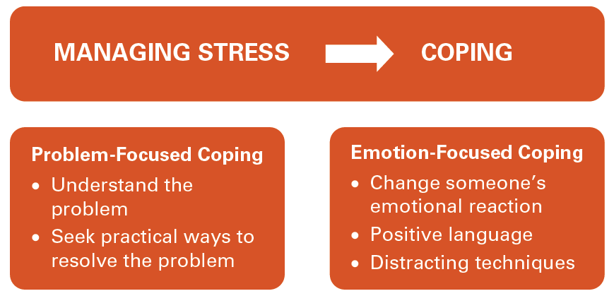
Figure 3.4: Managing Stress
Stress-related Outcomes and Wellness

Slide 14
Managing Work-Related Stress
Remove the stressor
  Minimize/remove stressors
  Work/life balance initiatives
  Work/life balance: Perception of balance between “work” and “leisure” activities
Withdraw from the stressor
  Vacation, rest breaks
Change stress perceptions
  Positive self-concept, humor
Control stress consequences
  Healthy lifestyle, fitness, wellness
Receive social support

Slide 15
Wellness
Stress-related Outcomes and Wellness
Wellness program is an effort to promote health and well-being by providing access to services like medical screenings, weight management, health advice, and exercise programs.
Notes:
We have seen that there are different degrees and types of stress and various ways of managing it. In recognition of the implications of stress, some organizations offer wellness programs as a way of helping their employees manage stress and otherwise protect and improve their health. A wellness program is a personal or organizational effort to promote health and well-being through providing access to services like medical screenings, weight management, health advice, and exercise programs. The main aim of the wellness program is to cultivate a healthier and more productive workforce that is more satisfied with their jobs.

Slide 16
Work-Life Balance
What did you think of the article?

Slide 17
Work-Life Balance
Definition: Perception of balance between “work” and “leisure” activities
Often area of focus: work-family balance and work-family conflict
Work-to-family conflict: When work interferes with family
Family-to-work conflict: when family interferes with work
Positive spillover: when positive experiences in one domain spill over to the other domain (e.g., you had a good day at work, and that carriers over positively to your relationships at home)

